Slide 1

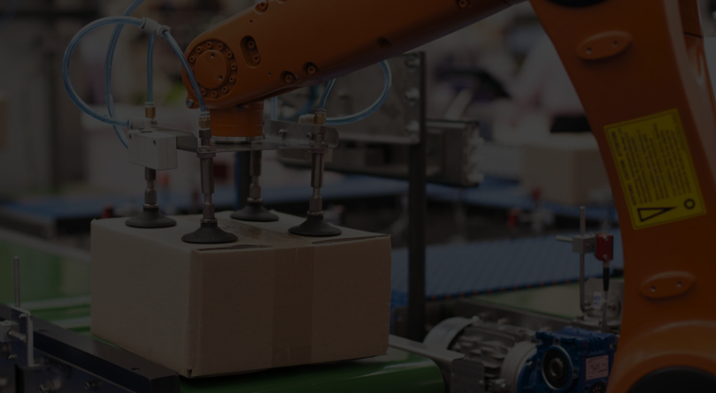


New Installer Experience
Project RAIDER
September 2019 Read Out

Slide 2

Description of the challenge
Based on the meetings one problem that was identified is regarding the acquisition of software products as well as updates and patches management.
At first the software is delivered to the client through an email which contains the urls that are used to download the binaries.
Then when the user needs to apply an update or patch to a certain product, another flow is used, which is the PCDC.
This creates two different UX that the user has to learn and use, when the underlying process is the same, deliver and consume content.
Globant Proprietary | Confidential Information

Slide 3
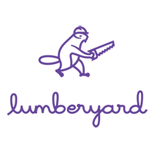




Benchmarks
The team did a research on Gaming Based Products that present similarities with RA:
Unreal Engine / Epics Games
Unity 3D
Lumberyard
CryEngine
Blizzard’s Battle.Net
Globant Proprietary | Confidential Information

Slide 4
Brief State of the Art of RA Tools
We have had multiple meetings with the RA team and product of them we identify the next RA tools that helps in the managing of the life cycle:
Common Installer: Which provides the mechanisms for performing a local installation of a RA product.
PCDC: Provides both a web platform and an API for downloading updates.
FactoryTalk Updater:
My Rockwell: A web platform that provides the needed features to download certain RA products, which are available for a user based on his entitlements.
Globant Proprietary | Confidential Information

Slide 5
Rockwell Automation HUB
The RA HUB is an experience central application:
Centralize the management of the life cycle.
Unify disjoint flows.
Single UX.
Scope
Centralize the management of the life cycle.
Unify disjoint flows.
Single Experience for all Rockwell Products and extensions.
Start with RAIDER (Maybe Studio 5000)
Globant Proprietary | Confidential Information

Slide 6
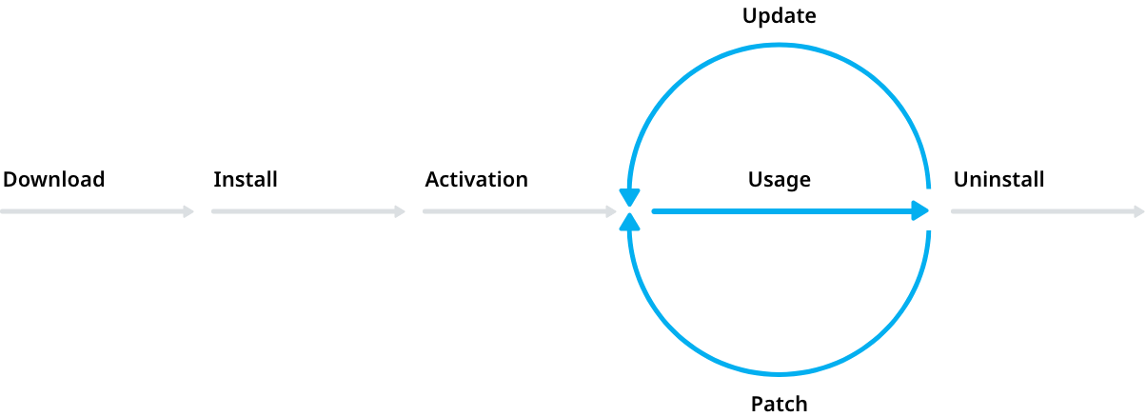
Product Deployment Lifecycle
RA HUB
Select a product, and proceed with the installation.
Transparent process (acquisition of binaries, type of installer).
Select among targets.
Update and patch any product.
List installed products.
Uninstall any product.
Activate a product.
Leverage with FactoryTalk Activation.
Globant Proprietary | Confidential Information

Slide 7
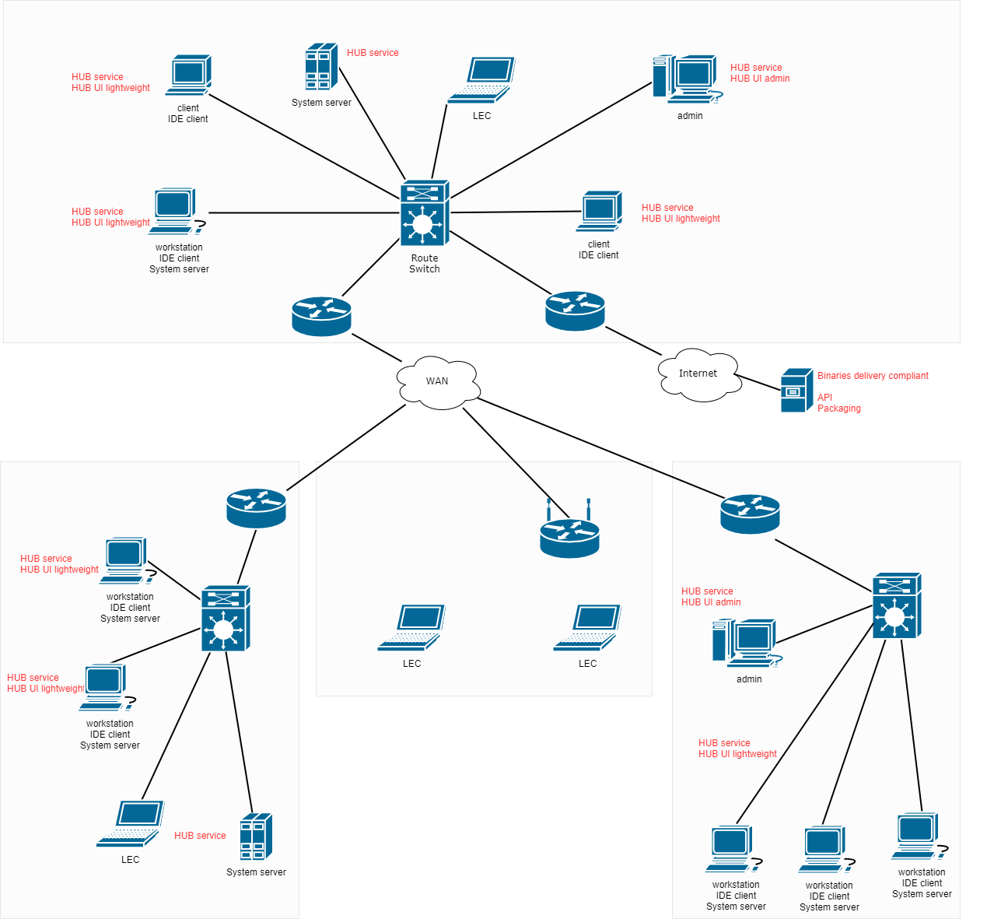
High Level Architecture
Globant Proprietary | Confidential Information

Slide 8
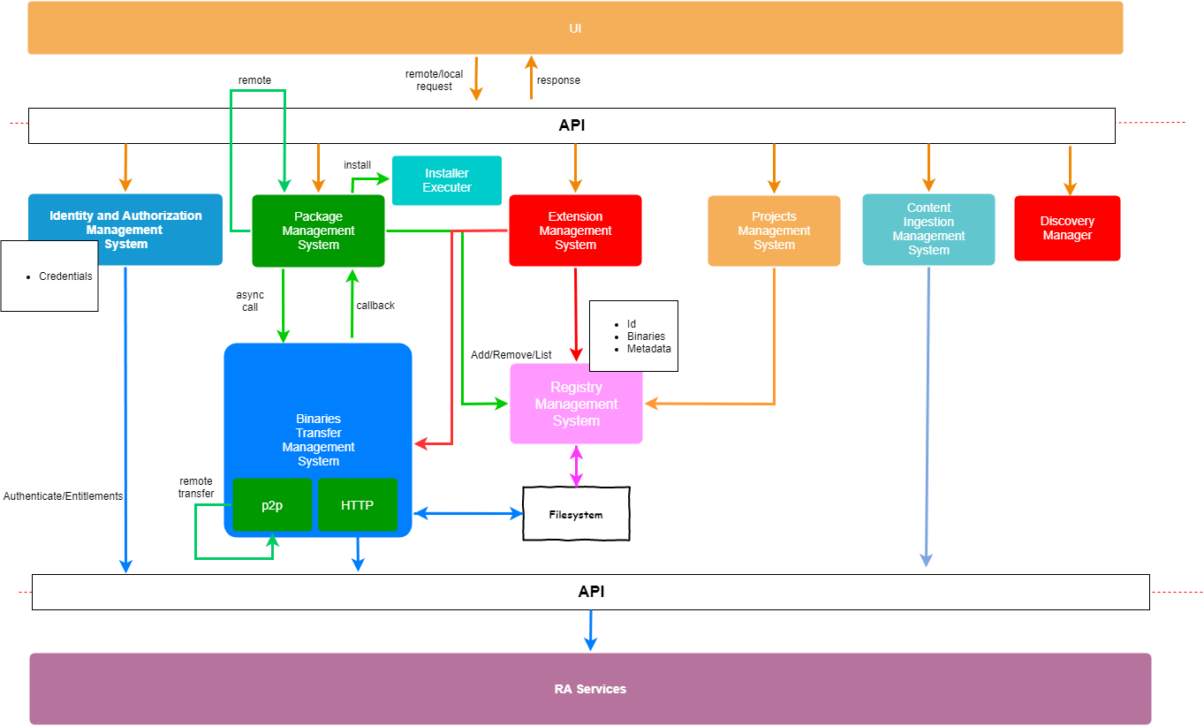
Main Systems Architecture
Globant Proprietary | Confidential Information

Slide 9
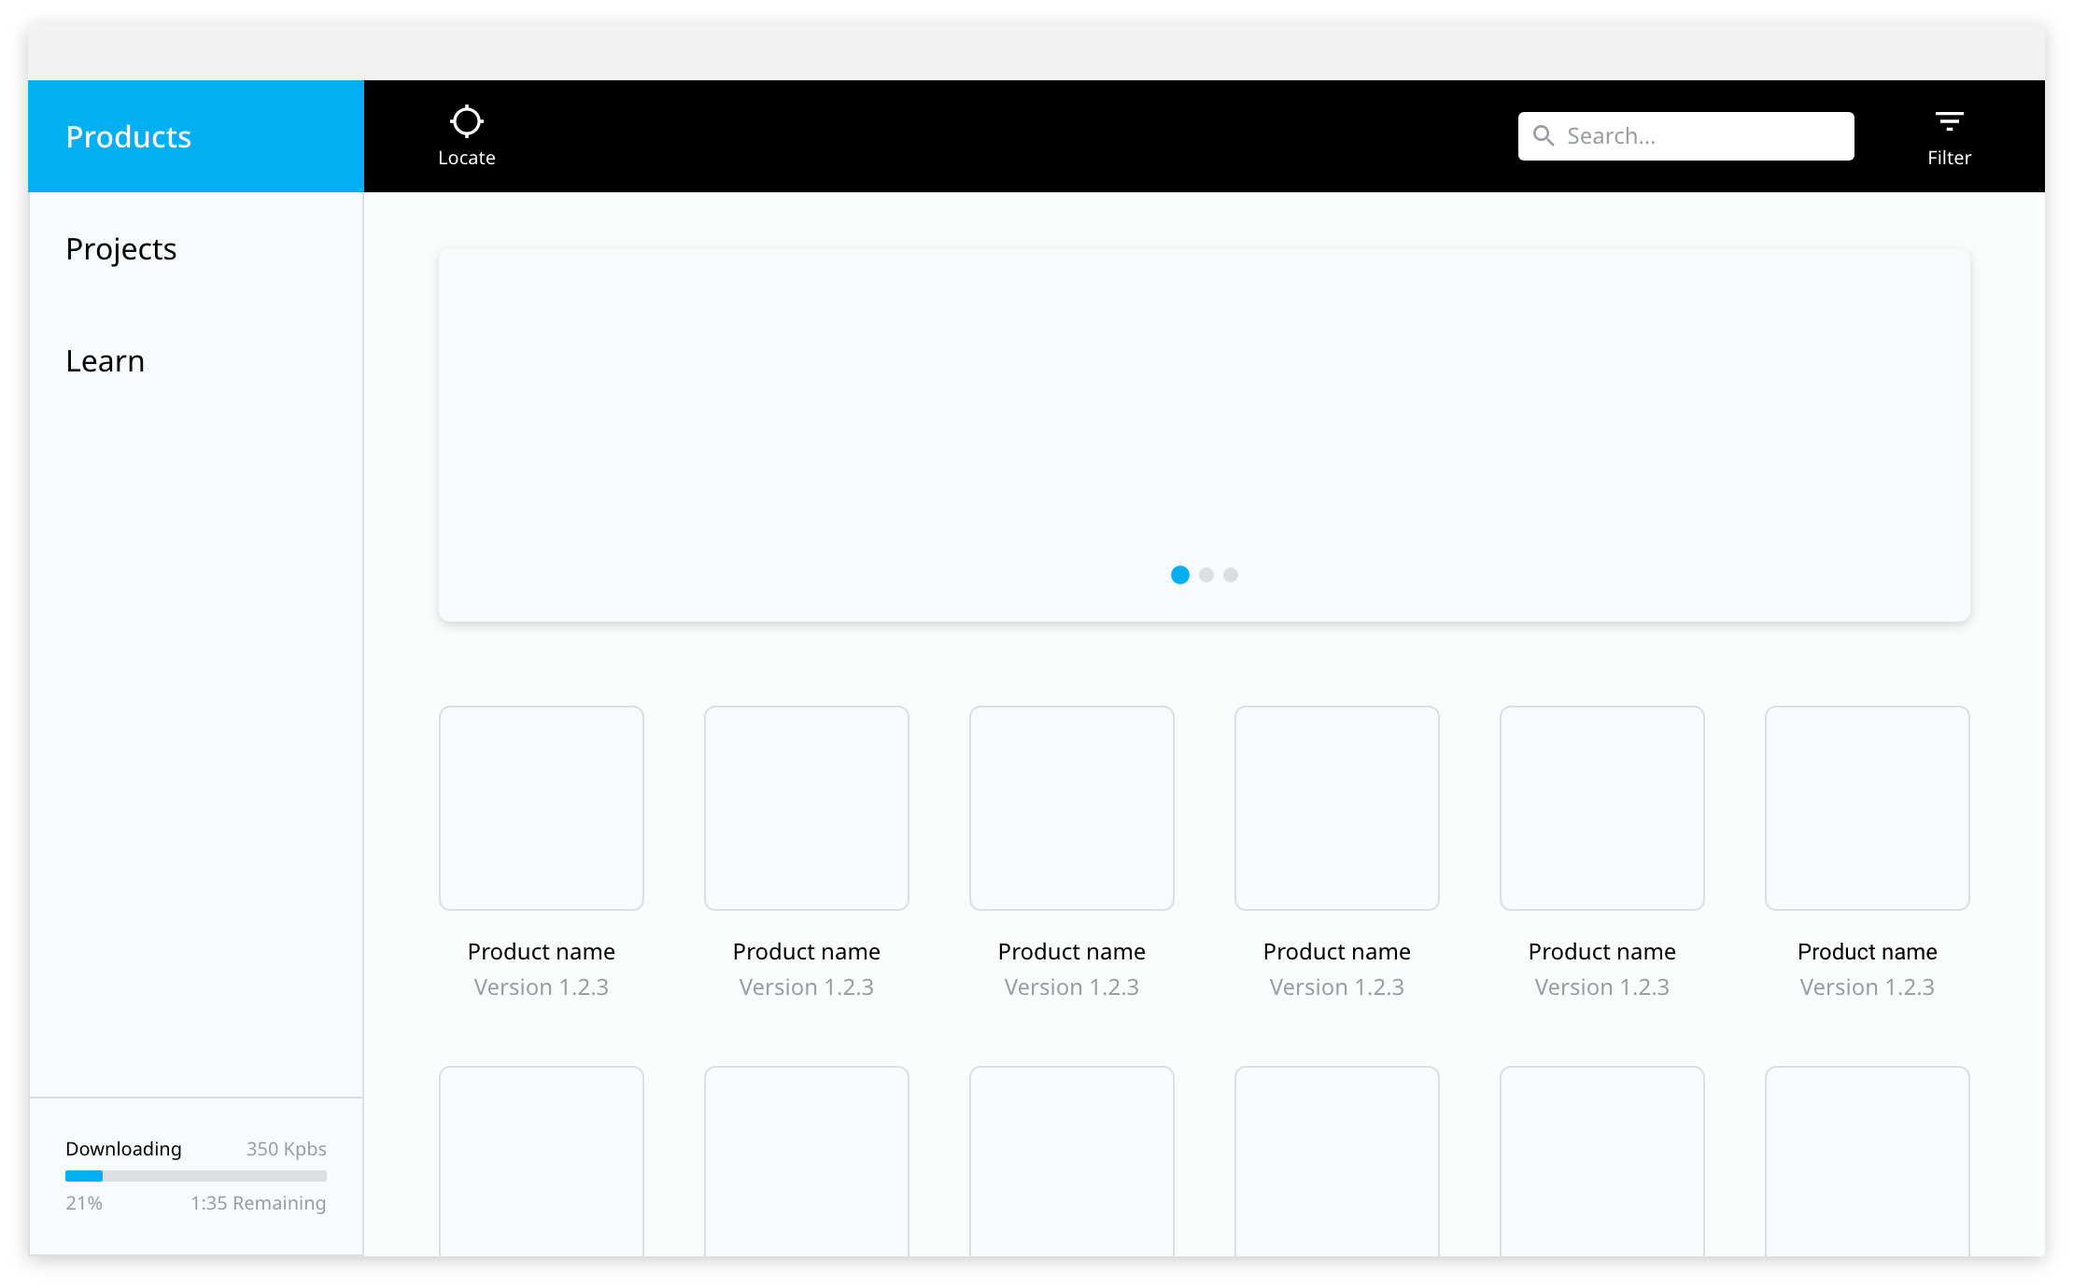
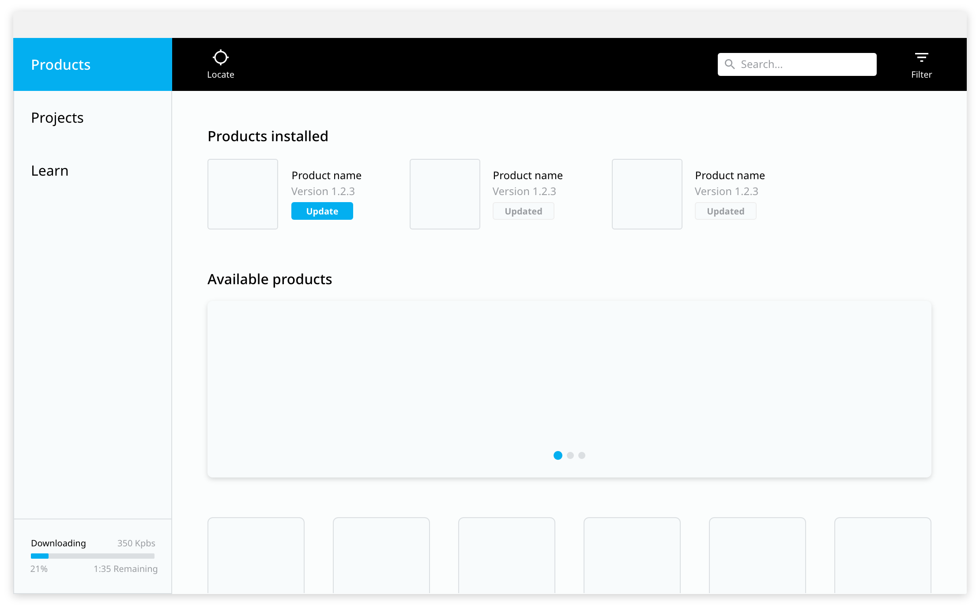
Mock Ups
Globant Proprietary | Confidential Information

Slide 10
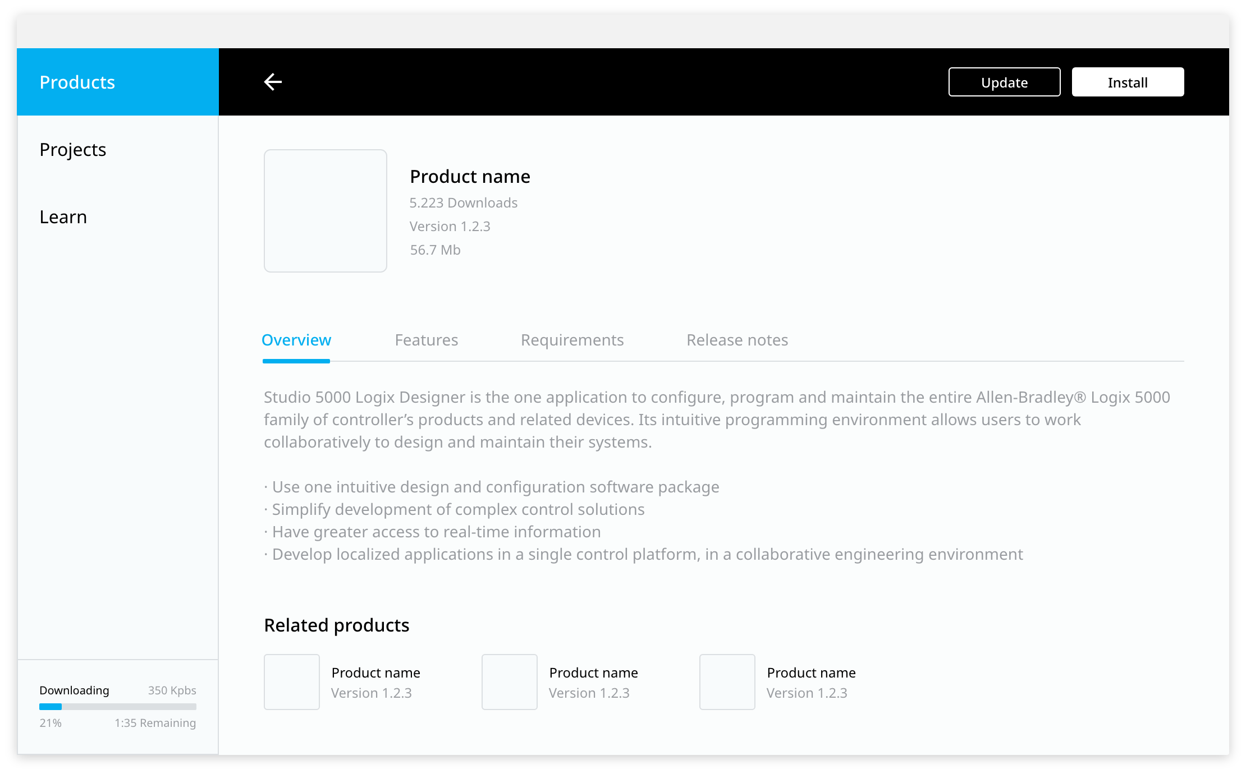
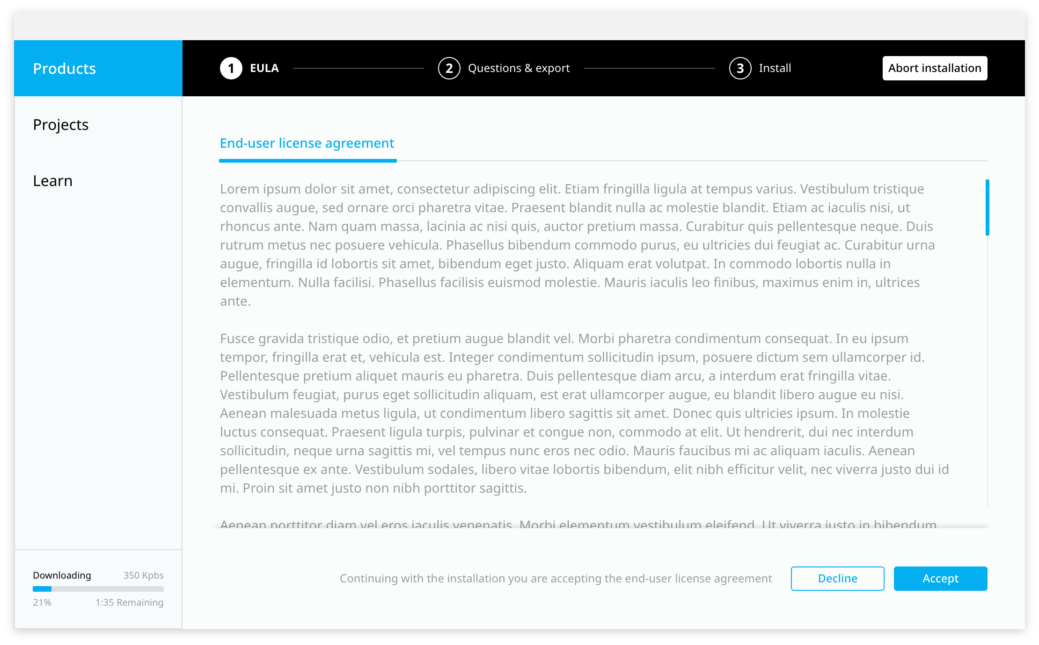
Mock Ups
Globant Proprietary | Confidential Information

Slide 11
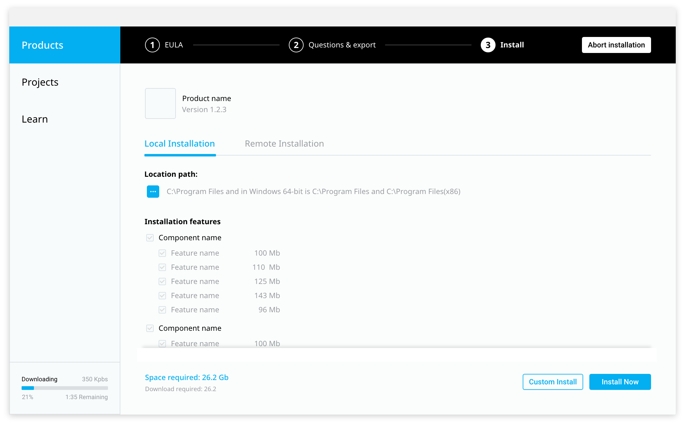
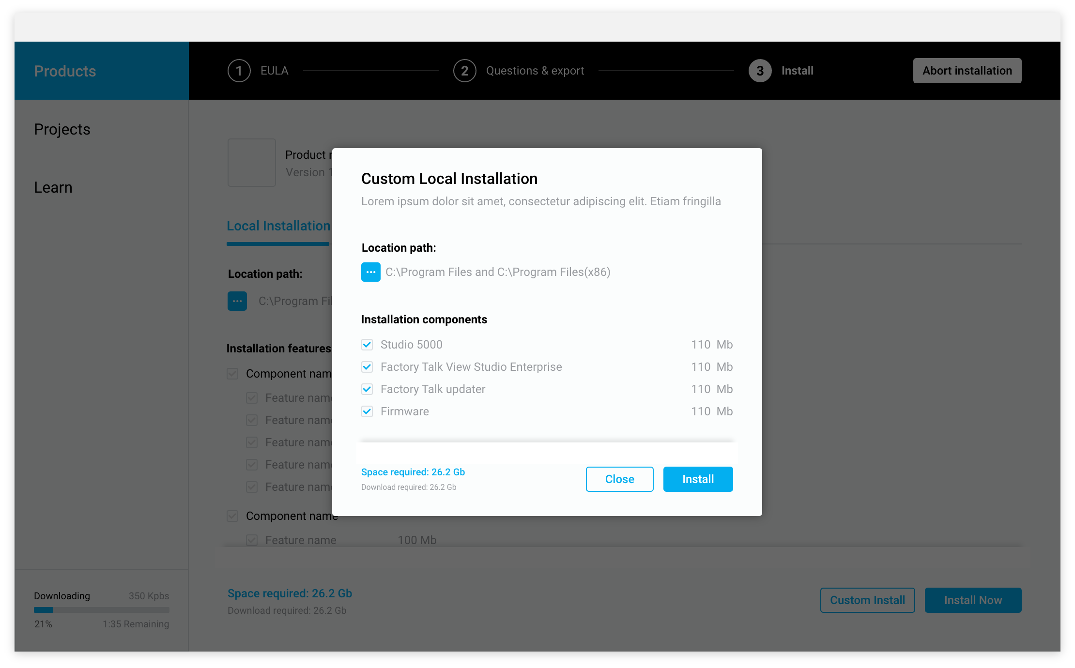
Mock Ups
Globant Proprietary | Confidential Information

Slide 12
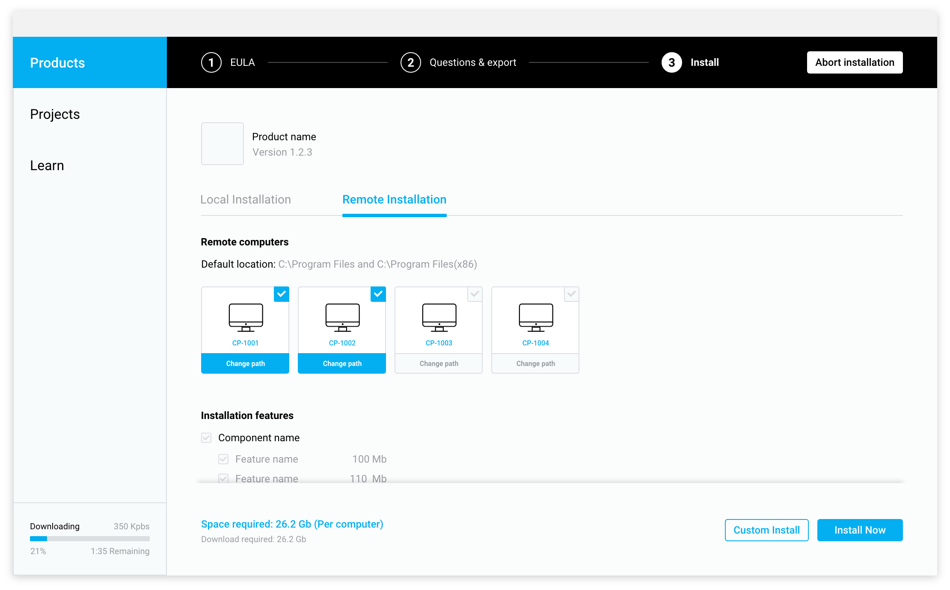
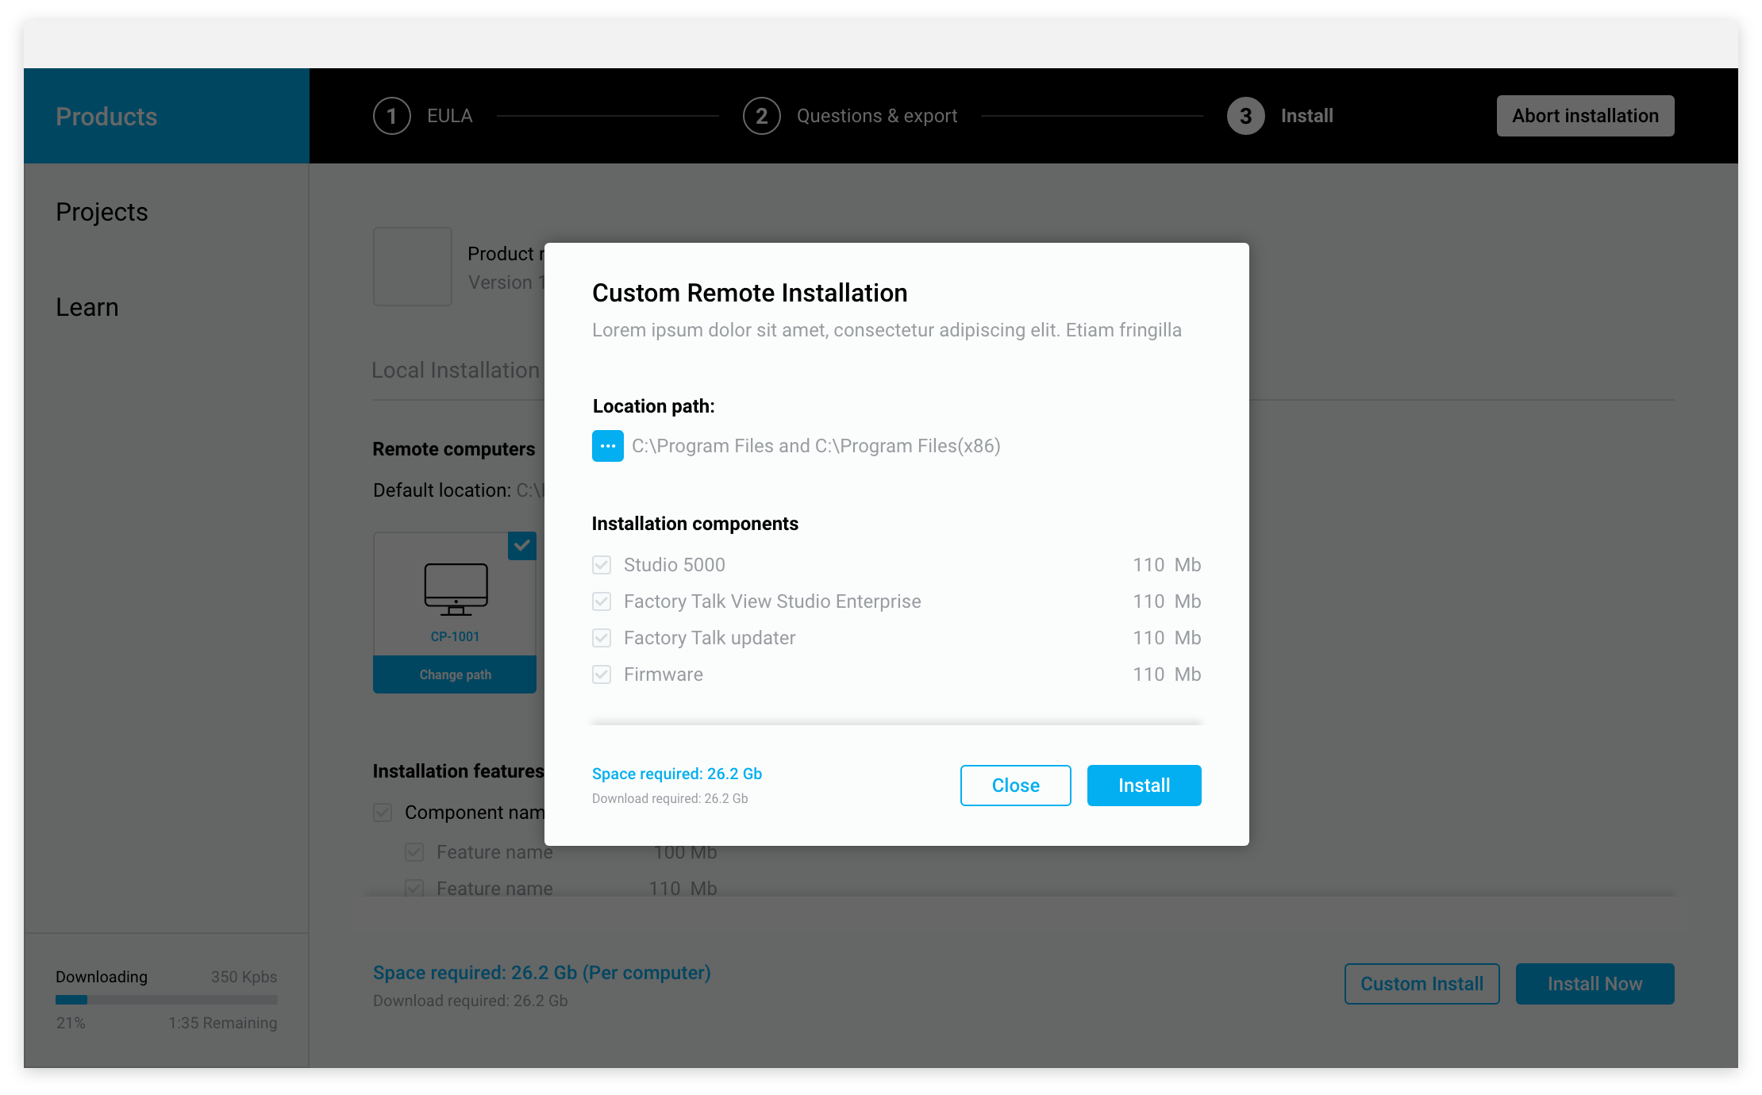
Mock Ups
Globant Proprietary | Confidential Information

Slide 13
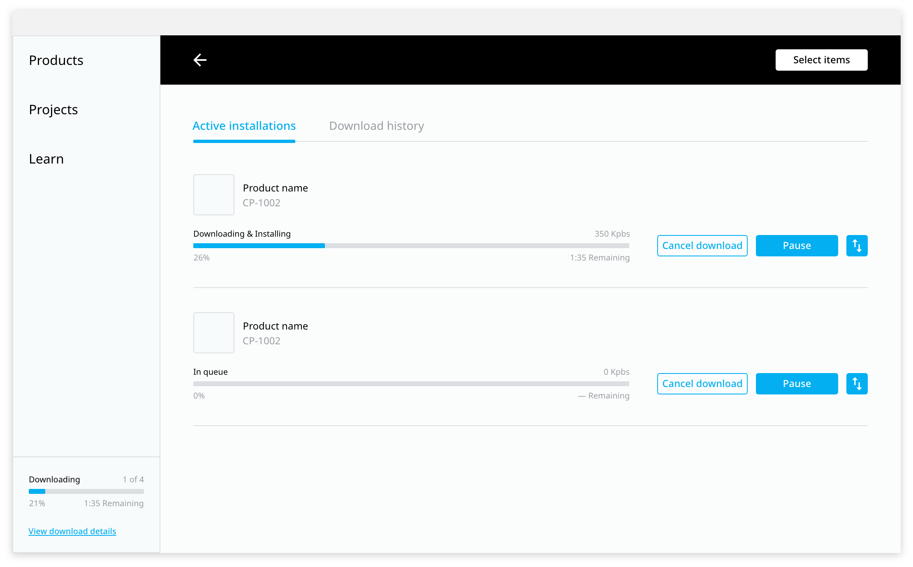
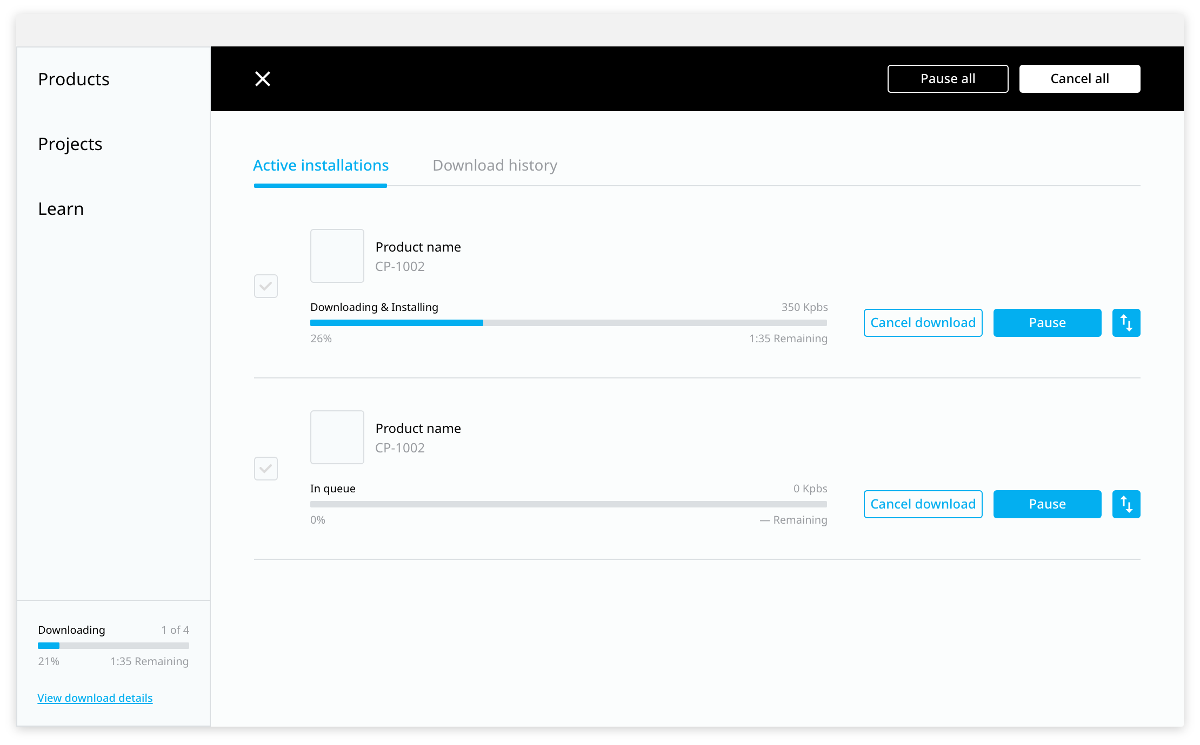
Mock Ups
Globant Proprietary | Confidential Information

Slide 14
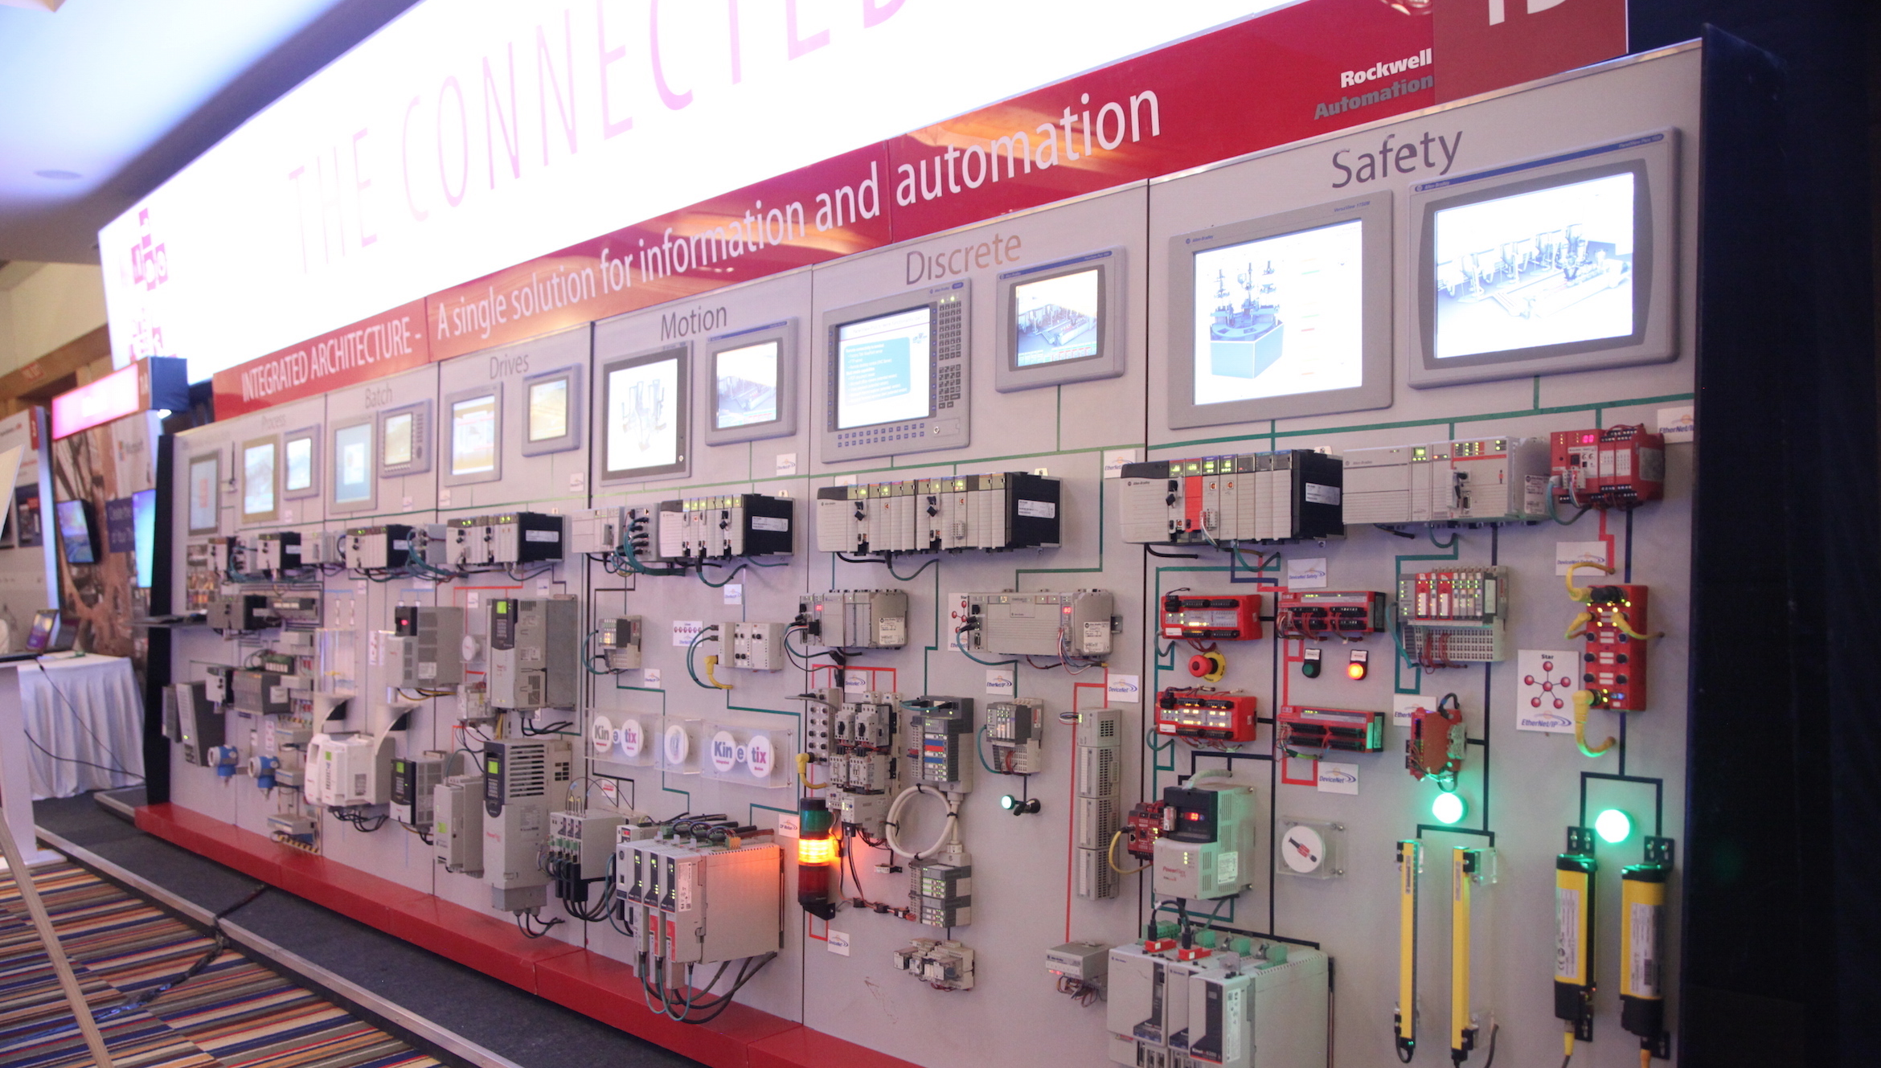

DEMO TIME

Slide 15
Summary
Two options non exclusive could be taken
Implement on top of current toolchain (mainly Common Installer)
Advantages:
Re use of already implemented code (Not all, but much of it, ie: PCDC API integration, MSI management).
C++/C# expertise of the team.
Disadvantages:
.NET requirement.
WPF is not cross-platform and is still available only on Windows.
WPF is an old technology, for which reason Microsoft suggests other frameworks
Globant Proprietary | Confidential Information

Slide 16
Summary
New Implementation aligned with RAIDER
Advantages:
Aligned with RAIDER Tech Stack.
Cross-platform.
Electron builder for build and packaging.
MSI, EXE, linux packages, among others.
State of the art technology.
Look & Feel from RAIDER.
Disadvantages:
.Not direct API for handling MSI installers .
Overhead in rewriting existing C#/C++ code to JS.
Globant Proprietary | Confidential Information

Slide 17
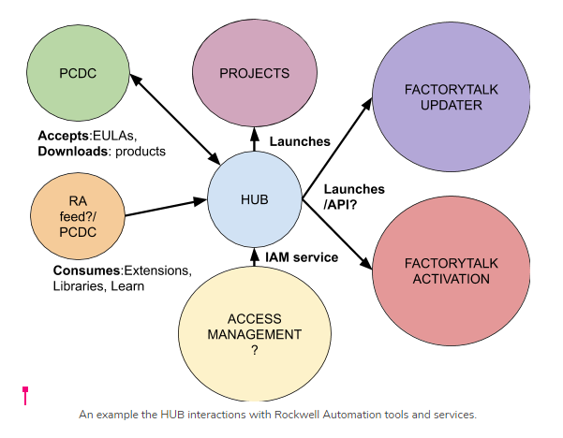
Final Remarks
Globant Proprietary | Confidential Information

Slide 18
Thank You

